Slide 1
Annual Work Plan & Budget Date: 14.05.2020
Project Approval Board Meeting 2020-21

Slide 2
New Interventions in 2019-20
State Govt. has increased Rs. 500/- per CCH per month from 01.04.2019 from its own resources.
MDM Module in Prerna Integrated Technical Framework facilitates online monitoring by Task Force members & daily reporting by Teachers.
Up to February, 2020 around 1,60,000 inspections done & data captured.
Target of inspections through “PRERNA System” is 75,000 for District Task Forces & Block Task Force per month and 1.5 Lakh for Academic Resource Persons per month.
Social Audit through Social Audit Directorate has been completed in 15 districts.
Cooking Competition for CCH has been organized in every districts. CCH from every block participated in the competition.
MOU with AKSHAYPATRA for 13 Districts. Kitchen setup in 3 Districts. Total 3,615 Schools & 3,38,885 children covered.

Slide 3
Physical Progress 2019-20
S.N. | Type | Enrollment as on 30.09.2019 | PAB Approval 2019-20 | Average Availing (Apr-Dec) | % against Enrollment | % against approval
1 | PS | 1,24,54,832 | 76,19,345 | 71,17,560 | 57% | 93%
2 | UPS | 57,38,832 | 33,18,872 | 31,14,710 | 54% | 94%
3 | TOTAL | 1,81,93,664 | 1,09,38,217 | 1,02,32,270 | 56% | 94%

Slide 4
Financial Progress 2019-20
Rs. In Cr.
 |  | Centre | State | Total | Centre | State | Total
1 | Cooking Cost (60:40) | 794.36 | 529.57 | 1323.93 | 800.06 | 533.37 | 1333.43 | 100%
2 | Cooks Honorarium (40:60) | 237.76 | 356.65 | 594.41 | 235.53 | 353.06 | 588.59 | 99%
3 | Cost of Foodgrain (100:00) | 80.02 | 0.00 | 80.02 | 79.26 | 0.00 | 79.26 | 99%
4 | Transportation Cost(100:00) | 45.05 | 0.00 | 45.05 | 22.43 | 0.00 | 22.43 | *50%
5 | MME (100:00) | 32.58 | 0.00 | 32.58 | 32.58 | 0.00 | 32.58 | 100%
 | कुल | 1189.77 | 886.22 | 2075.99 | 1169.86 | 886.43 | 2056.29 | 99%
Head (Centre : State)
Received in 2019-20
Expenditure in 2019-20
%
* Expenditure is only 50% because of GoI has sanctioned fund@ Rs. 1500/- per MTs. while payment done @ Rs. 750/- per MTs. During 2019-20.

Slide 5
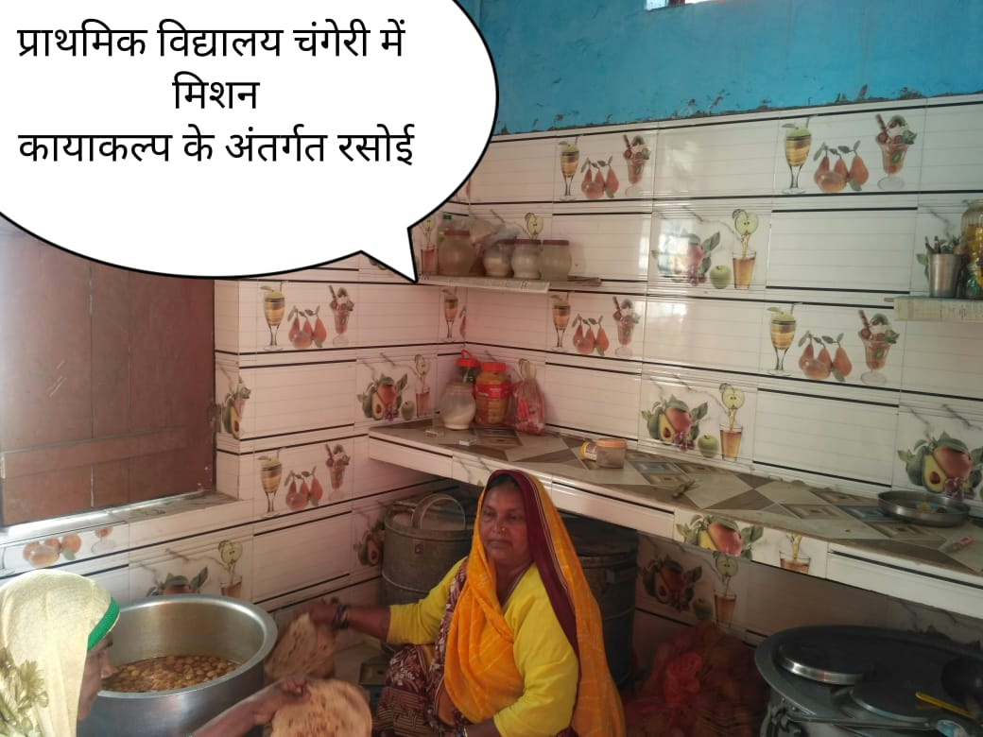
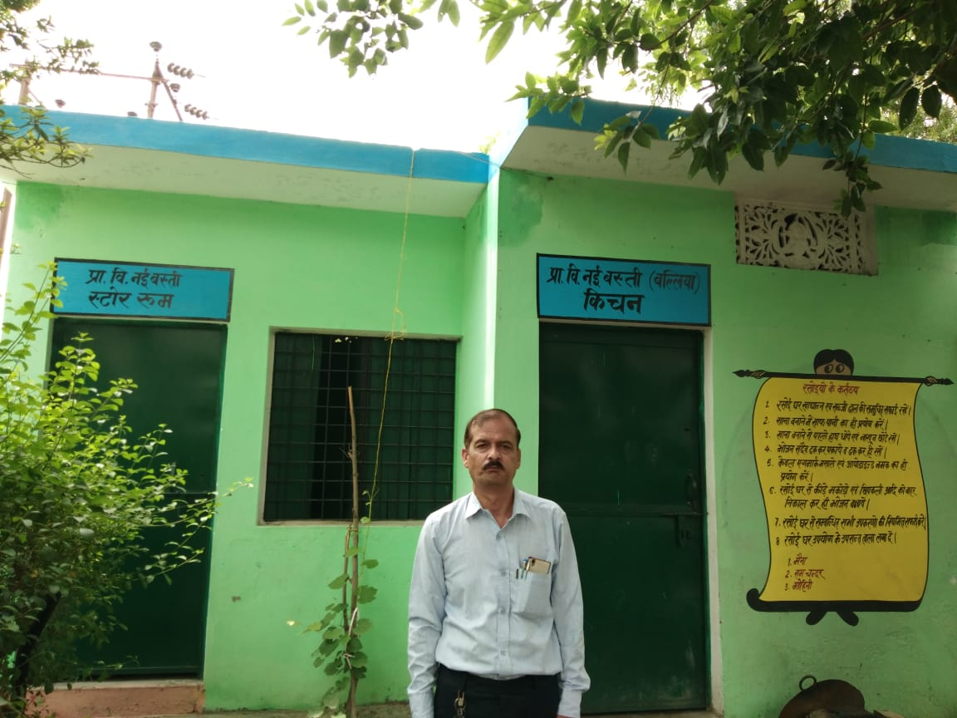
OPERATION KAYAKALP
Operation “KAYAKALP” was inaugurated by Hon’ble CM to Saturate the basic infrastructure facilities in schools which also includes Kitchen Shed, Hand Washing & Drinking Water Facilities for MDM.
Saturation is targeted in this financial year 2020-21.
ऑपरेशन कायाकल्प के अंतर्गत हैण्डवाशिंग की व्यवस्था

Slide 6
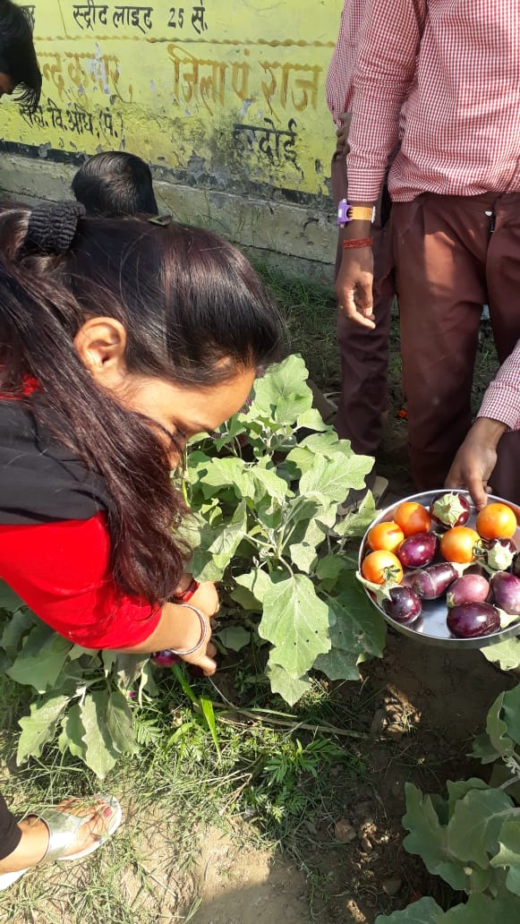
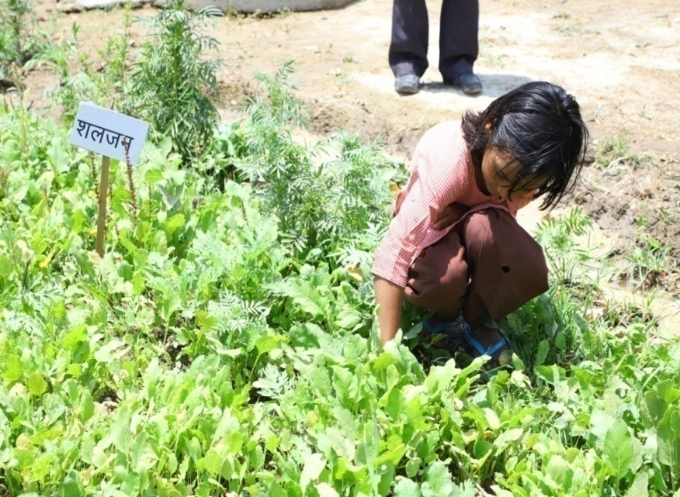
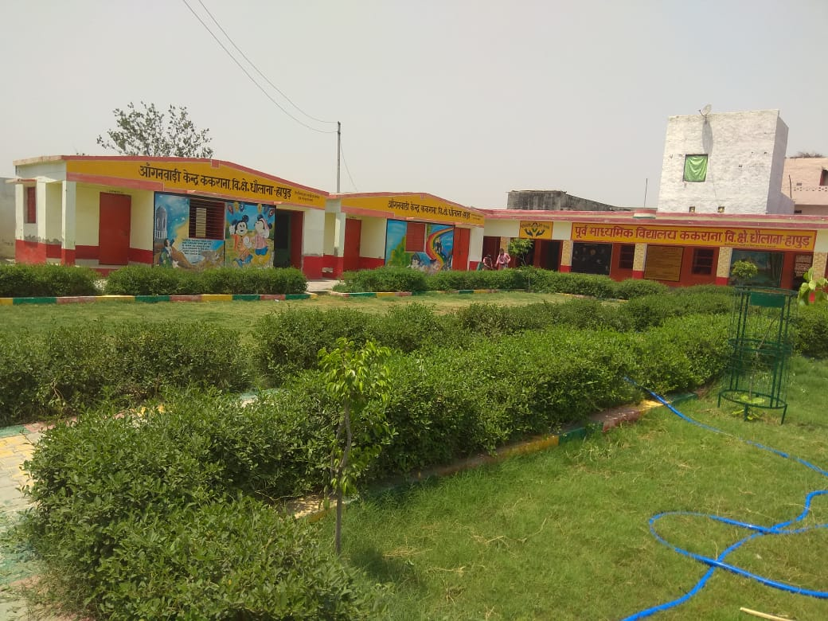
Kitchen Garden in Schools
पू०मा०वि० ककराना, धौलाना, हापुड़
Total no. of Schools already have Kitchen Garden: 9118
No. of Schools where Kitchen Garden setup is in progress: 3689
Proposed for setting up Kitchen Garden in 30,000 schools in 2020-21.

Slide 7
Cooking Competition of Cooks
Cooking competition of CCH were organized in all districts.
Top three CCH participants were awarded Rs. 3500/- for 1st, Rs. 2500/-, 1500/- for 3rd.
Rs. 250/- of consolation prize for remaining participants.
A committee of Judges consisting of following members was created in each district–
Basic Shiksha Adhikari
District Inspector of Schools
Principal of GGIC.
Home Science Professor.
10 Students of Class 5-8.
Chef of reputed hotel.
One female officer of district.
One officer from food safety department.

Slide 8
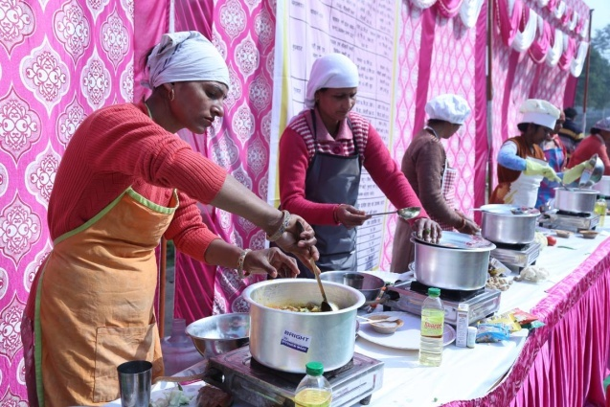
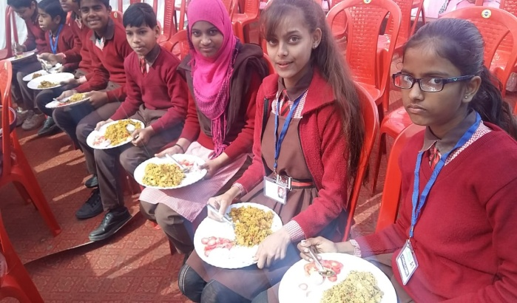
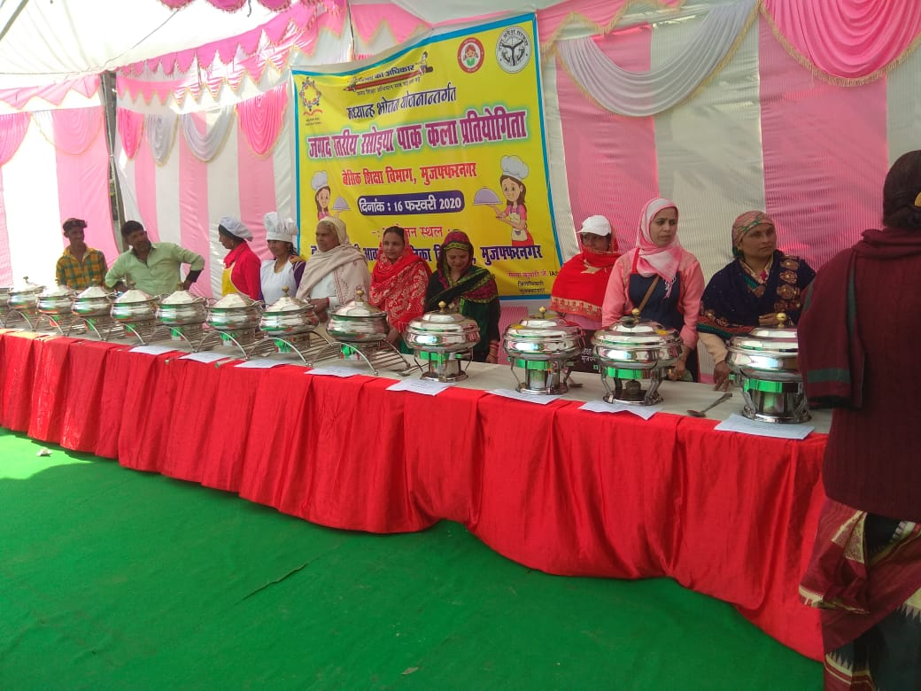
Cooking Competition of Cooks
GHAZIYABAD
AYODHYA
LUCKNOW
MUZAFFARNAGAR

Slide 9
Proposed for 2020-21
An exhaustive training programme has been planned for year 2020-21 for chairman & vice chairman of each SMC & CCH of each schools. The training will start after the restrictions for covid-19 are relaxed.
A Global Tender for involvement of reputed NGOs/Organizations is being planned for providing nutritional meal to children.
For providing nutritional support to children it is being proposed to setup Kitchen Gardens in 30,000 schools. Model of kitchen garden and its estimate has already been provided to schools. Convergence with GP funds & MNREGA will be ensured.
PFMS System is being planned to start fund transfer for scheme components.

Slide 10
Proposal for 2020-21
No. of Schools
S.N. | School Type | Primary | Upper Primary | STC | Total
1 | Govt. | 22 | 533 | 0 | 555
2 | Local Body | 1,12,224 | 45,687 | 0 | 1,57,911
3 | Govt. Aided | 567 | 7,670 | 0 | 8,237
4 | Madarasa | 69 | 482 | 0 | 551
5 | STC | 0 | 0 | 61 | 61
 | Total | 1,12,882 | 54,372 | 61 | 1,67,315
Working Days
Primary | Upper Primary | STC
249 | 249 | 310

Slide 11
Proposal for 2020-21
No. of Children
Primary | Upper Primary | STC | Total
79,75,431 | 35,03,168 | 1,285 | 1,14,79,884
Foodgrain (In MTs.)
Foodgrain | Primary | Upper Primary | STC | Total
RICE | 1,33,054.115 | 87,665.028 | 40.035 | 2,20,759.178
WHEAT | 65,534.117 | 43,178.297 | 19.718 | 1,08,732.132
TOTAL | 1,98,588.232 | 1,30,843.325 | 59.753 | 3,29,491.310

Slide 12
Proposal for 2020-21
Kitchen Device (Replacement)
Total No. of Existing Schools = 1,67,575
Released to districts for replacement in 2019-20 = 14,777
Rs. In Lakh
Enrollment | No. of Schools | Rate | Centre | State | Total
1-50 | 24,612 | 10,000 | 1,476.72 | 984.48 | 2,461.20
51-150 | 83,423 | 15,000 | 7,508.07 | 5,005.38 | 12,513.45
151-250 | 24,983 | 20,000 | 2,997.96 | 1,998.64 | 4,996.60
>=251 | 7,653 | 25,000 | 1,147.95 | 765.30 | 1,913.25
TOTAL | 140671* | - | 13,130.70 | 8,753.80 | 21,884.50
* Replacement will be provided only in Govt. & Local Body Schools.

Slide 13
Proposal for 2020-21
Rs. In Cr.
Head (Centre:State)
Approved in 2019-20
Proposed in 2020-21
 |  |  | Centre | State | Total | Centre | State | Total
1 | Cooking Cost (60:40) | परिवर्तन लागत (60:40) | 857.38 | 570.38 | 1427.76 | 981.87 | 655.24 | 1637.11
2 | Cooks Honorarium (40:60) | रसोइया मानदेय (40:60) | 238.18 | 357.27 | 595.45 | 234.34 | 351.52 | 585.86
3 | Cost of Foodgrain (100:00) | खाद्यान्न लागत (100:00) | 85.14 | 0.00 | 85.14 | 90.17 | 0.00 | 90.17
4 | Transportation Cost (100:00) | परिवहन व्यय (100:00) | 47.83 | 0.00 | 47.83 | 49.42 | 0.00 | 49.42
5 | MME (100:00) | एम०एम०ई० (100:00) | 33.17 | 0.00 | 33.17 | 36.60 | 0.00 | 36.60
6 | Kitchen Devices (60:40) | किचन उपकरण (60:40) | 55.34 | 36.89 | 92.23 | 131.31 | 87.54 | 218.85
7 | Flexi Fund (5% of total budget) | फ्लेक्सी फण्ड (कुल बजट का 5%) | 62.49 | 41.66 | 104.15 | 78.54 | 52.36 | 130.90
 | Total | कुल | 1379.53 | 1006.20 | 2385.73 | 1602.28 | 1146.66 | 2748.94
 | *Fund Required for summer |  | - | - | - | 229.50 | 133.96 | 363.46
 | Grand Total |  | 1379.53 | 1006.20 | 2385.73 | 1831.78 | 1280.62 | 3112.40
* Details Given in next slide – Demand for Summer Vacation 2020-21
Total 15% increase is propose in budget against previous year due to -
Increase in enrolment by 2% in 2020-21
Increase in attendance by 5% in 2020-21
Increase in Cooking Cost by 10.99% in 2020-21

Slide 14
Demand For Summer Vacation 2020-21
Rs. In Cr.
S.N. | Head | Primary | U.Primary | Total
1 | Enrolment | 12454832 | 5738832 | 18193664
2 | Working Days | 32 | 32 | 32
3 | Rate of Cooking Cost | 4.97 | 7.45 | -
4 | Rate of Foodgrain | 100 gm | 150 gm | -
5 | RICE | 26703.160 | 18456.084 | 45159.244
6 | WHEAT | 13152.302 | 9090.310 | 22242.612
7 | TOTAL Foodgrain (In MTs) | 39855.462 | 27546.394 | 67401.856
8 | COOKING COST – Centre | 118.85 | 82.09 | 200.94
9 | State | 79.23 | 54.73 | 133.96
10 | Total | 198.08 | 136.82 | 334.90
11 | Cost Of Foodgrain | 10.91 | 7.54 | 18.45
12 | Cost of Transportation | 5.98 | 4.13 | 10.11
13 | Total – Centre | 135.74 | 93.76 | 229.50
14 | Total – State | 79.23 | 54.73 | 133.96
15 | Total Fund Required | 214.97 | 148.49 | 363.46

Slide 15
Flexi Fund Proposal for 2020-21
Proposal for Flexi Fund
30,000 schools are being proposed for setting of kitchen garden in F.Y. 2020-21
Fund Required-
30,000 x 5,000 = Rs. 15,00,00,000/-
Rs. 15.00 Crore (C.A. of Rs. 9.0 Cr. & State Share of Rs. 6.0 Cr.) is required.
Proposed for additional nutritional supplements like chikki/ gud patti or other which will be locally available @ Rs. 4.00 per child per day etc for Aspirational districts (8) in State.
S.N. | Districts | No. of Children | Days (July-March) | Fund Required (in Cr.) @ Rs. 4.00 per Child Per Day
 |  |  |  | Centre | State | Total
1 | BAHRAICH | 289509 | 212 | 14.730 | 9.820 | 24.550
2 | BALRAMPUR | 172935 | 212 | 8.800 | 5.860 | 14.660
3 | CHANDAULI | 145031 | 212 | 7.380 | 4.920 | 12.300
4 | CHITRAKOOT | 104696 | 212 | 5.330 | 3.550 | 8.880
5 | FATEHPUR | 192828 | 212 | 9.810 | 6.540 | 16.350
6 | SHRAWASTI | 81663 | 212 | 4.160 | 2.770 | 6.930
7 | SIDDHARTHNAGAR | 200810 | 212 | 10.220 | 6.810 | 17.030
8 | SONBHADRA | 164781 | 212 | 8.380 | 5.590 | 13.970
 | TOTAL | 13,52,253 | 212 | 68.810 | 45.860 | 114.670
Note: Remaining balance of flexi fund (if available) will be utilized in other priority blocks (consisting of children from Poor/ST/SC community)

Slide 16
Additional Demand 2020-21
Social Audit Proposed in all districts.
In last PAB, GoI has approved fund for fruit distribution once in a month under flexi fund.
In compliance of the above, State distributed fruit to all students once in a month (last Thursday) from July 2019 upto Feb, 2020.
(Rs. In Lakh)
S.No. | Type | Average Availing (Apr-Dec) | Centre | State | Total
1 | Primary | 71,17,560 | 1366.57 | 911.05 | 2277.62
2 | U. Primary | 31,14,710 | 598.02 | 398.68 | 996.71
 | Total | 1,02,32,270 | 1964.59 | 1309.73 | 3274.33
Fruits has been provided @ Rs. 4.00 per child per week.

Slide 17
धन्यवाद

